Slide 1
CSYE7200 Big-Data Sys Engr Using Scala
Analyzing Ethereum Transactions
Team 3
Ronit Mankad
Porom Sivam Kalita
Charmi Nimishkumar Dalal

Slide 2
Use Cases
1
3
2
User can monitor live dashboards to find latest trends in the Ethereum market
Organizations can identify scams in real-time
Data Scientists can perform predictive analysis on Ethereum prices

Slide 3
Methodology
Purpose: To analyze the full set of transactions which have occurred on the Ethereum network from the first transactions 2016 till 2019 using Big data tools such as Kafka and Spark.
Download chunk of dataset from BigQuery and store locally.
Use Spark-Streaming API to read the CSV file and write to Kafka topic as stream of records
Use Spark-Streaming API to consume data stream from the Kafka Topic and load it as a data frame.
Store the transformed data into MySQL and use Apache Superset to create visualizations of relevant data
CSV file (Local system) -> Spark (Producer) -> Kafka -> Spark (Consumer) -> MySQL -> Apache Superset

Slide 4




Architecture
Kafka Topics
DataProducer.scala
eth_transactions
StreamingConsumer.scala
writes
reads
eth_blocks
writes
pulls
JDBC

Slide 5





Environment Setup
Local Installation

Slide 6



Data Source
https://console.cloud.google.com/marketplace/product/ethereum-classic/
Big query crypto currency Ethereum dumps daily. We download it in csv format and save it locally.
We use the transaction and blocks tables
Number of rows are approximately 30,000 per data table

Slide 7

Milestones/Sprints
Project
Project Set Up (1 Apr – 7 Apr)
Write
Write Consumer & Producer Logic (8 Apr – 14 Apr)
Perform
Perform data transformation according to need of analysis (15 Apr – 21 Apr)
Create
Create dashboards to visualize data (22 Apr – 27 Apr)

Slide 8
What will you program in Scala?
Kafka Producer to simulate data stream of transactions
Stream Consumer to read from Kafka through Spark-Streaming API
Batch Consumer to enable computation of Non-Stream Data
Test Cases to ensure Query performance and reliability
https://github.com/charmiidalal/ethereum-analysis-csye7200

Slide 9


Acceptance criteria
Live dashboard configured to pull the data every 10 seconds
Data sent to the kafka topic loads it into a data frame every second.

Slide 10
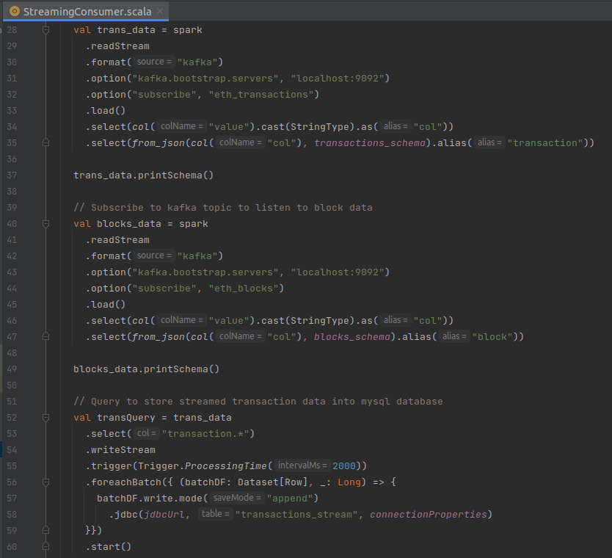
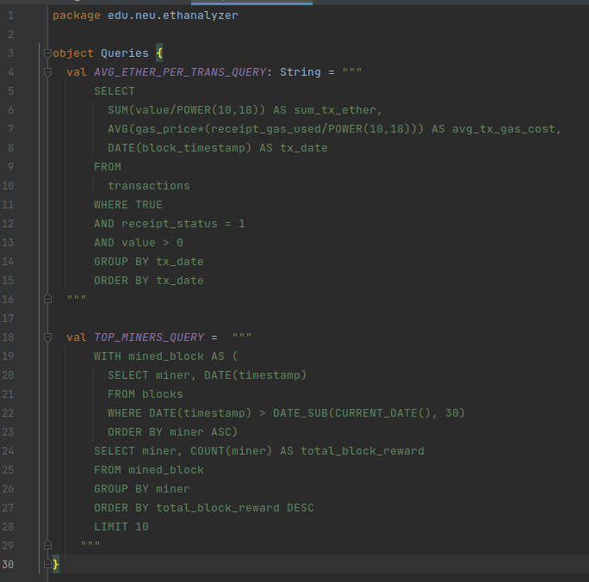
Code Snippets

Slide 11
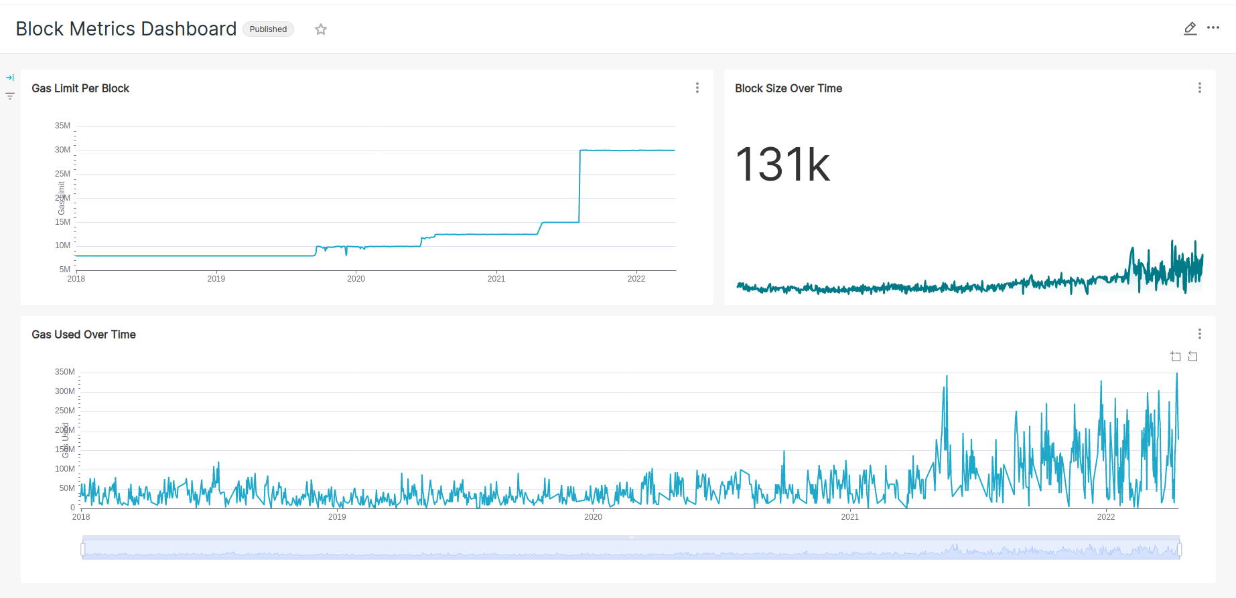
Dashboards #1

Slide 12
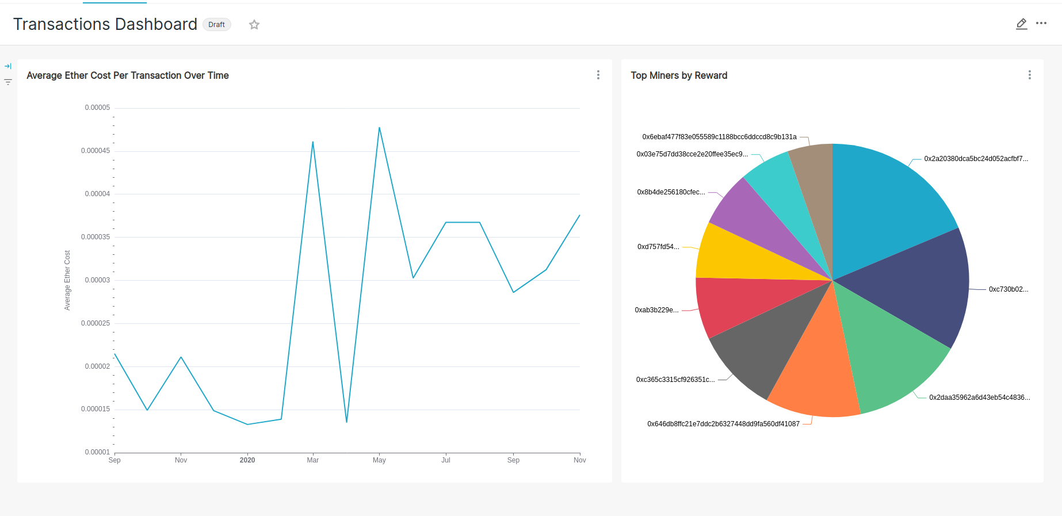
Dashboards #2

Slide 13
Goals of the project
Simulate Data Generation - Utilize Kafka Producer to simulate an environment where transactions take place in real time
Perform Distributed Aggregations - Utilize Spark to perform complex aggregations on large datasets
Create Live Dashboards in Superset – Configure dashboards to refresh every 10 seconds to monitor KPIs

Slide 14
Future Improvement
More test coverage - Integration tests, more robust Query performance and reliability testing
Better utilization of Structured Streaming API - Use features like Watermarks, Windows to get running aggregations
More Efficient, “Non Hacky” way of ingesting data into Kafka

Slide 15
Any Questions?

Slide 16

Thank You

